Slide 1
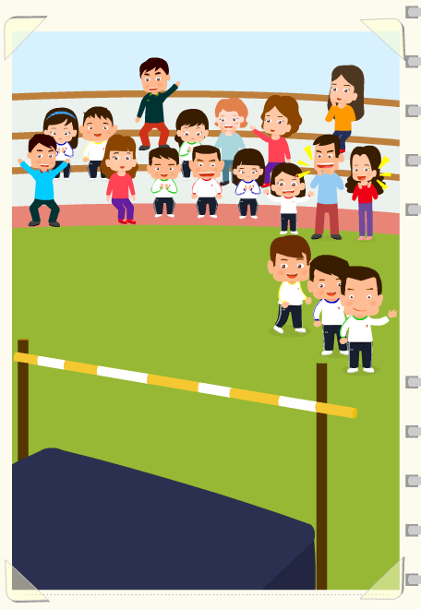
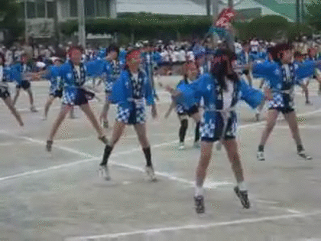
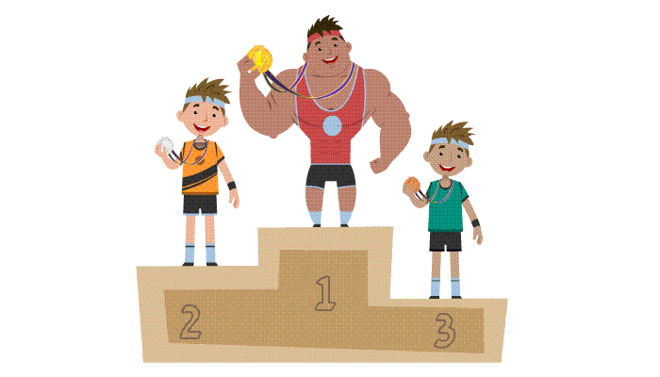
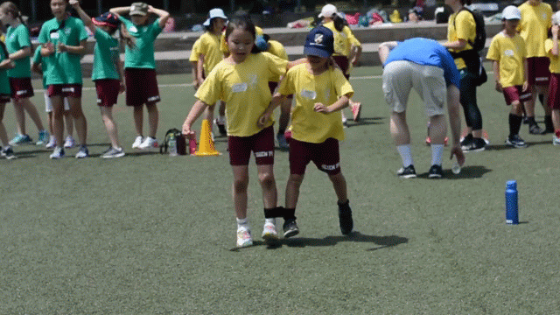
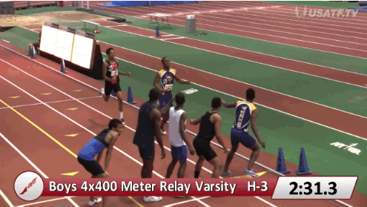
high jump跳高
aerobic dance健身操
welcome dance大會舞
relay race接力
fun game趣味賽
three-legged race兩人三腳

Slide 2
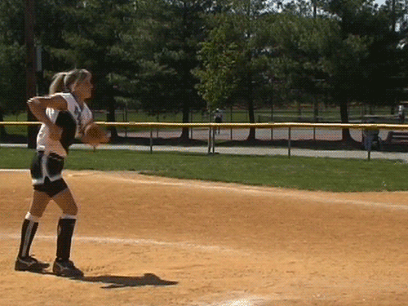
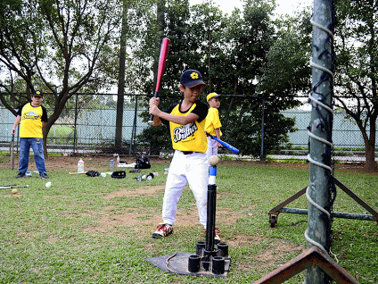
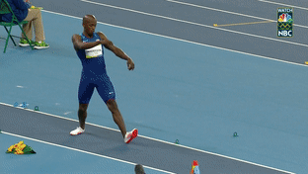
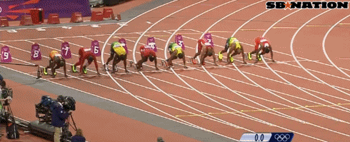
softball throw壘球擲遠
Tee Ball樂樂棒
100 meters race百米賽跑
long jump跳遠

Slide 3
messy and neat

Slide 4
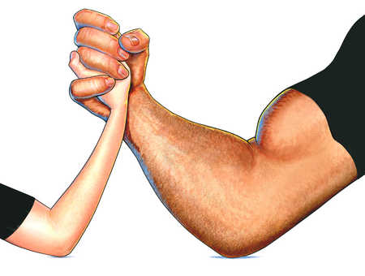
weak and strong

Slide 5
young and old

Slide 6
shy and outgoing

Slide 7
noisy and quiet

Slide 8
heavy and thin

Slide 9
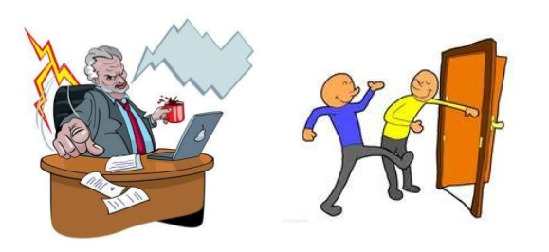
rude and polite

Slide 10
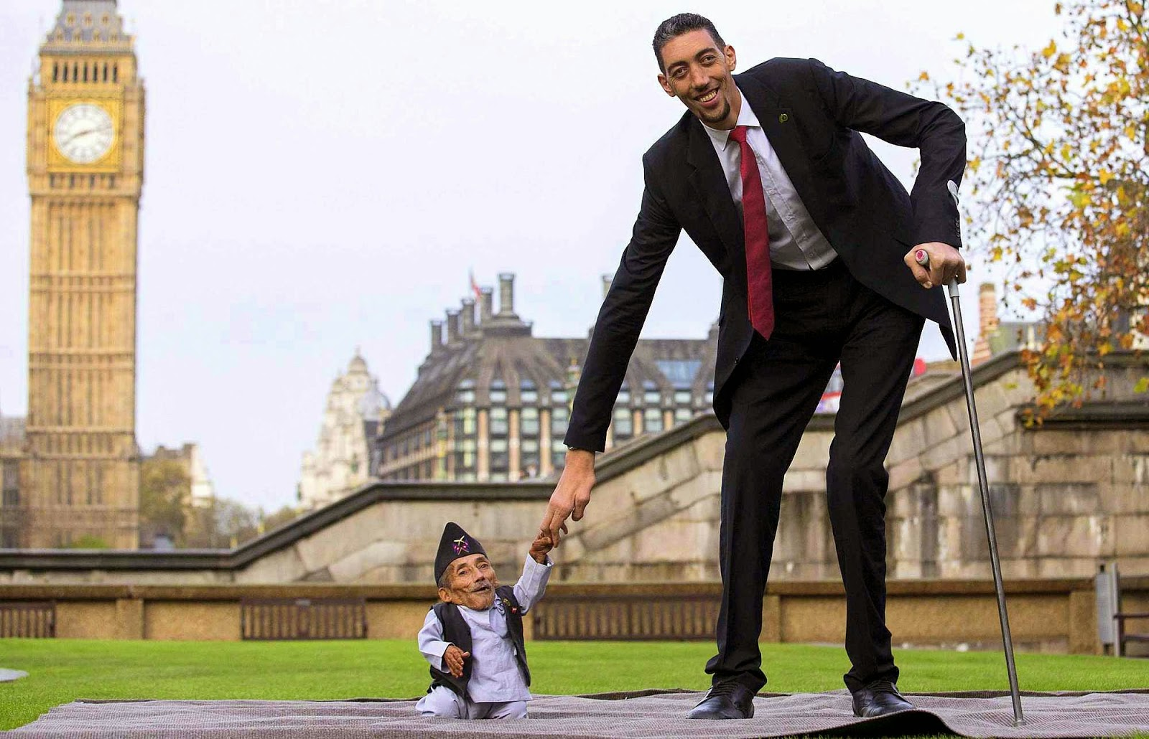
short and tall

Slide 11
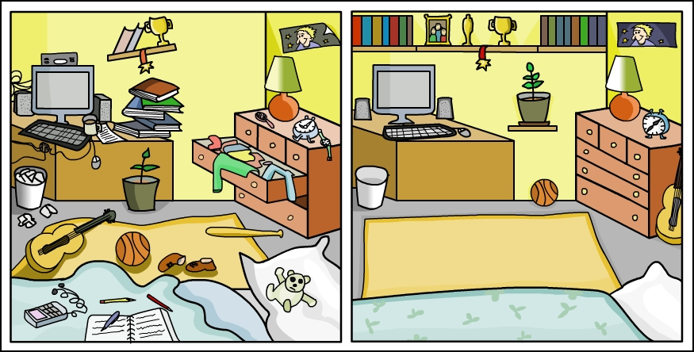
I was neat before,
but I am messy now.

Slide 12
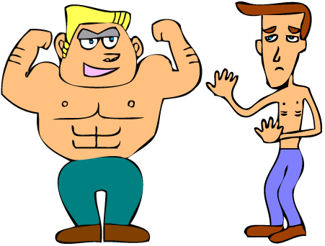
He was strong before,
but he is weak now.

Slide 13
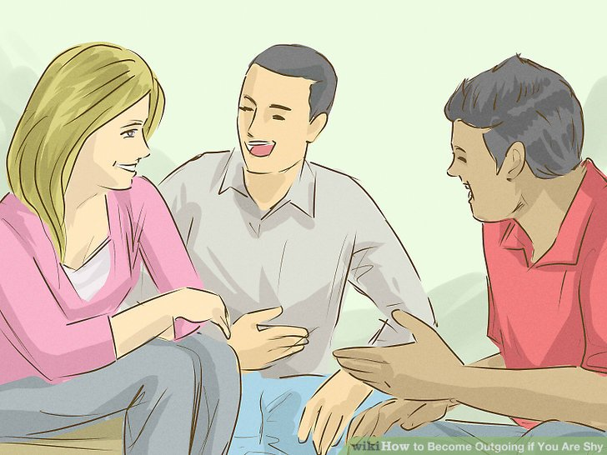
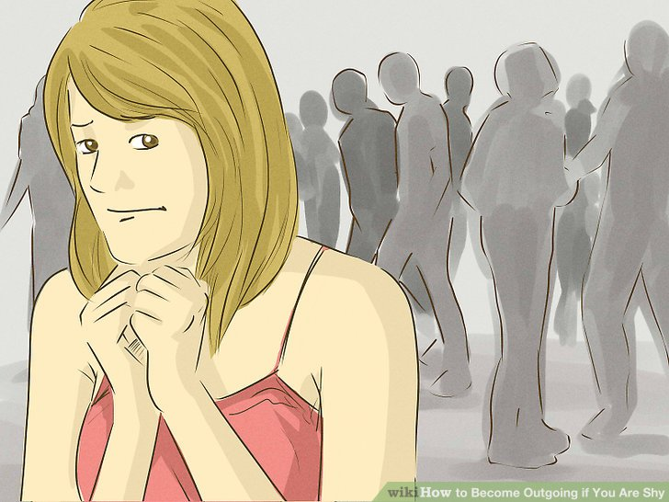
She was outgoing before,
but she is shy now.

Slide 14
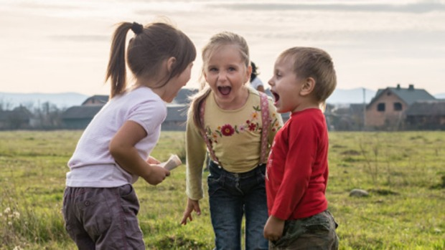
We were noisy before,
but we are quiet now.

Slide 15
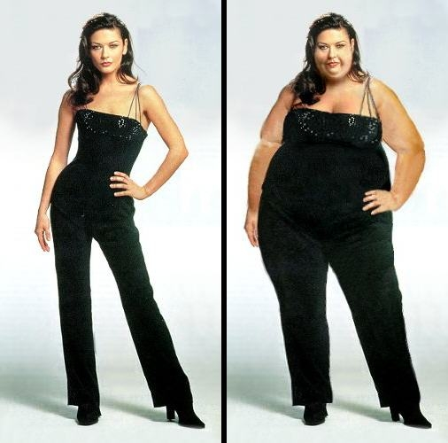
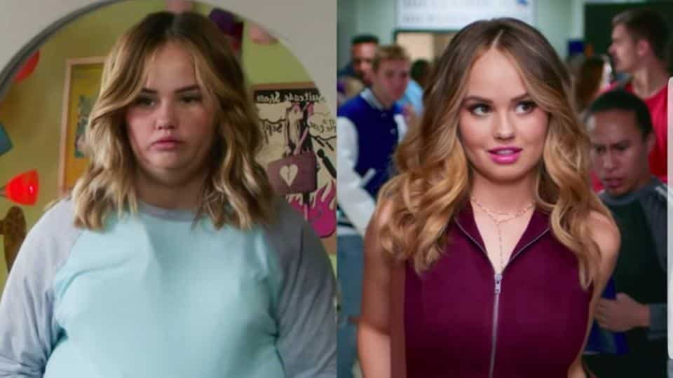
They were heavy before,
but they are thin now.

Slide 16
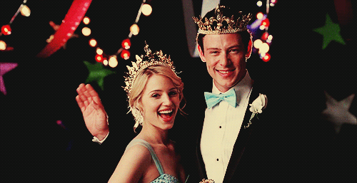
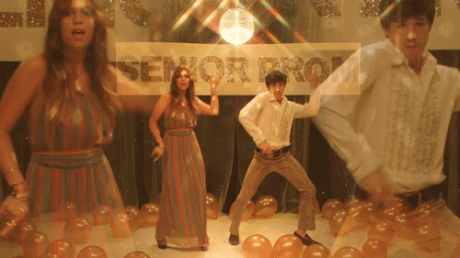
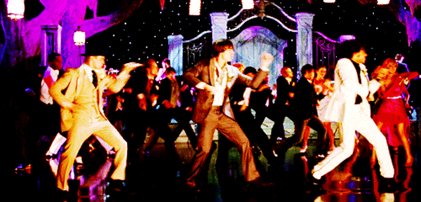
Senior Prom (promenade)

Slide 22
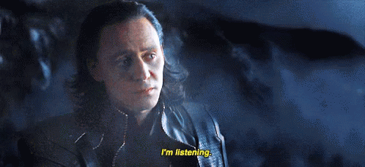

Slide 23
True or False?
1. Judy wants to go to the prom with Patrick.
False! Ella does.

Slide 24
True or False?
2. Judy is more outgoing than Ella.
Ture! Ella said so.

Slide 25
3. Why does Patrick want to get strong?
Because he wants to join the soccer team.

Slide 26
4. What is Patrick afraid of?
He’s afraid of Ella might say no to him.

Slide 27
5. Where are they going to meet before the dance?
At Carlos’s house.

Slide 28
6. Does Ella feel happy going to the ball with Patrick?
Yes, she said “Thank you for asking. “ to him.

Slide 29
V
V
V

Slide 30
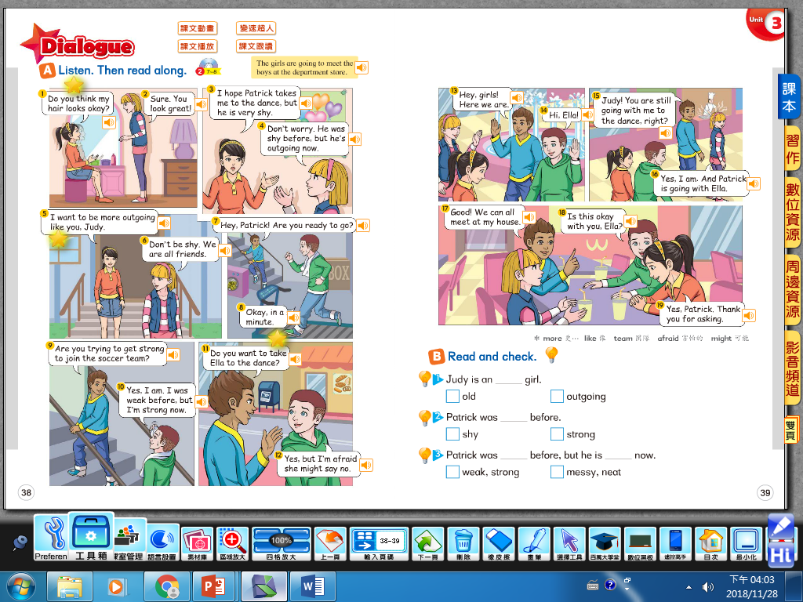

Slide 31
【本週英語作業】
1.聽:CD2 Unit3全。
2.背:Unit 3的8組相反形容詞，
共16個單字，下週上課小考。

Slide 33
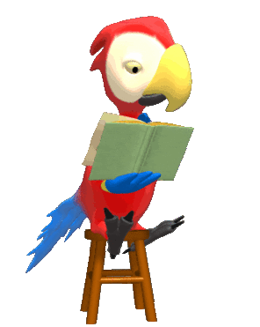
Copy the intonation of CD!

Slide 34
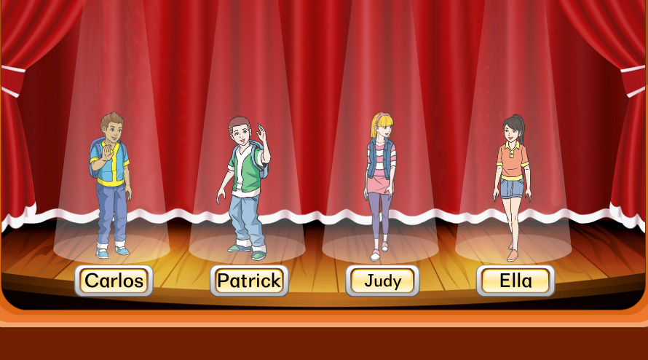
Role Play

